Slide 1

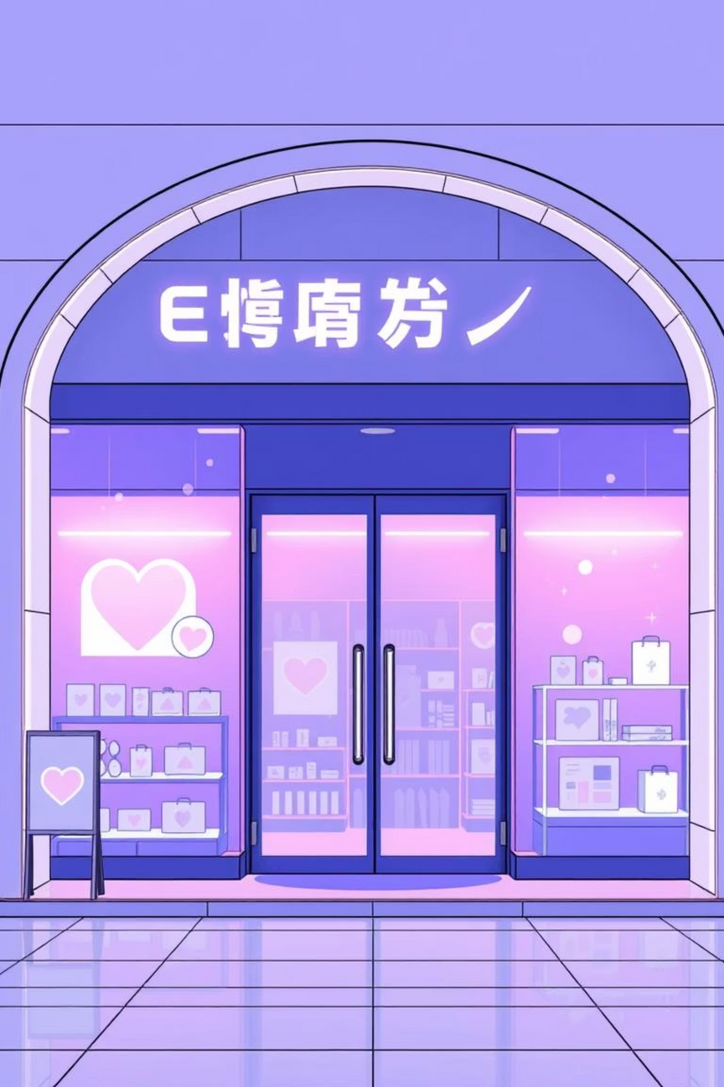
E-commerce Application
Presented by: Patel Yash

Slide 2

Project Overview: MERN E-commerce
This full-stack e-commerce solution is built on the robust MERN (MongoDB, Express.js, React, Node.js) stack, offering a seamless and secure online shopping experience.
1
2
3
Full-Stack Application
MERN Stack Foundation
User-Centric Design
A comprehensive shopping platform developed using modern web technologies.
Leveraging MongoDB, Express.js, React, and Node.js for a powerful and efficient architecture.
Intuitive user interface coupled with robust backend security features.

Slide 3
Core Technologies Utilized
Frontend Excellence
Robust Backend & Database
Security & Communication
React.js: Dynamic UIs
Node.js: Server-side Logic
JWT Auth: Secure Tokens
Redux Toolkit: State Management
Express.js: Web Application Framework
OTP System: Two-Factor Authentication
Material UI: Modern Components
MongoDB: NoSQL Database
Email Configuration: Notifications

Slide 4




Key User Features
Product Interaction
Personalized Wishlist
Comprehensive search, add, edit, and delete product reviews.
Curate favorite items with personal notes for future purchases.
Seamless Shopping Cart
Order & Profile Management
Manage item quantities and view real-time subtotal calculations.
Track order history and update personal details, email, and addresses.

Slide 5
Comprehensive Admin Capabilities
The admin panel offers powerful tools for managing products and orders, ensuring efficient operation of the e-commerce platform.
1
2
Product Management
Soft Delete Option
Admins can effortlessly add, edit, and delete products from the catalog.
Products can be soft-deleted, allowing for temporary removal without permanent data loss.
3
4
Order Supervision
Protected Routes
View and update order statuses, ensuring smooth fulfillment and customer satisfaction.
Admin-specific routes are securely protected, accessible only to authorized personnel.

Slide 6
Enhanced Security Measures
Our e-commerce application integrates robust security features to protect user data and ensure secure transactions.
JWT Authentication
1
Secure user sessions with JSON Web Tokens for API authorization.
OTP Verification
2
Implement one-time password systems for critical actions.
Password Reset
3
Secure password reset functionality with time-sensitive expiry links.
Email Verification
4
Confirm user identities through email-based verification processes.
Cookie & Token Management
5
Effective handling of cookies and authentication tokens for seamless user experience.

Slide 7
Data Seeding & Demo Usage
Quickly populate your database with sample data and explore the application using pre-configured demo accounts.
Email Verification
Pre-configured Demo
A real email address is required to test OTP and password reset functionalities.
Sample Data Insertion
A demo account is ready with sample products, users, and reviews for immediate exploration.
Use npm run seed to effortlessly insert sample data into your database.

Slide 8
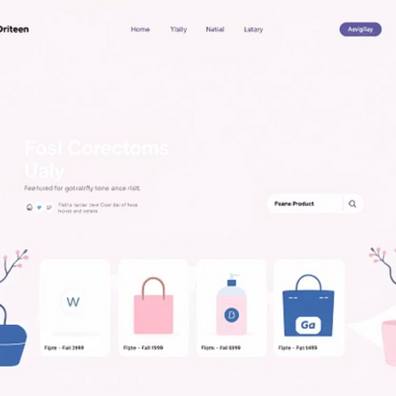
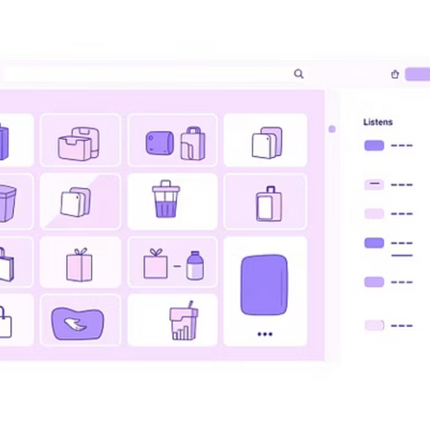
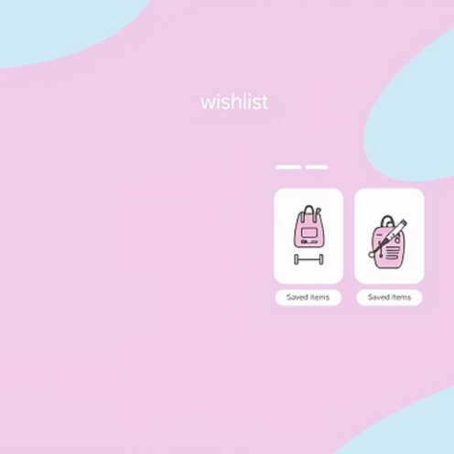
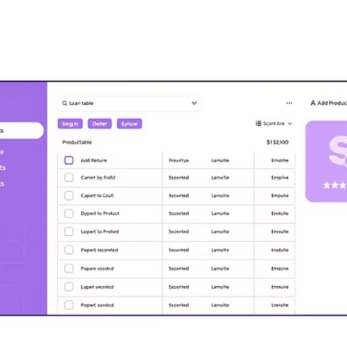
Application UI Highlights
Explore the intuitive and visually appealing interface of the e-commerce application through key screen captures.

Slide 9
Conclusion & Future Outlook
The MERN E-commerce application delivers a secure, scalable, and modern shopping experience built on best practices.
Complete Functionality
User-Friendly Design
A fully-fledged e-commerce platform with all essential features.
Intuitive interfaces for both end-users and administrators.
Secure & Scalable
Modern Architecture
Built with security at its core, designed for future growth.
Developed using clean code and industry best practices.

